Slide 1
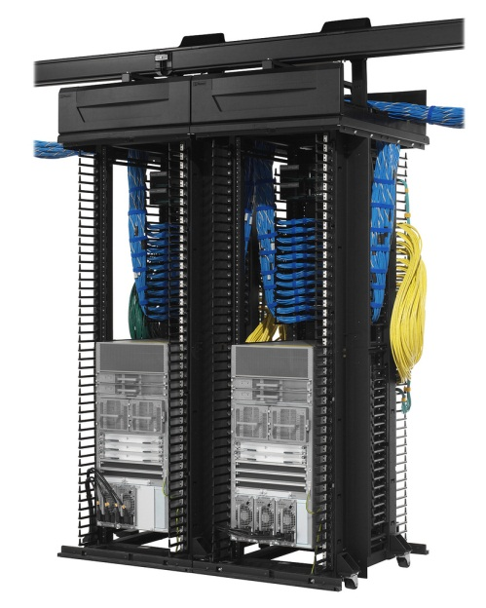

Switching
STP

Slide 2

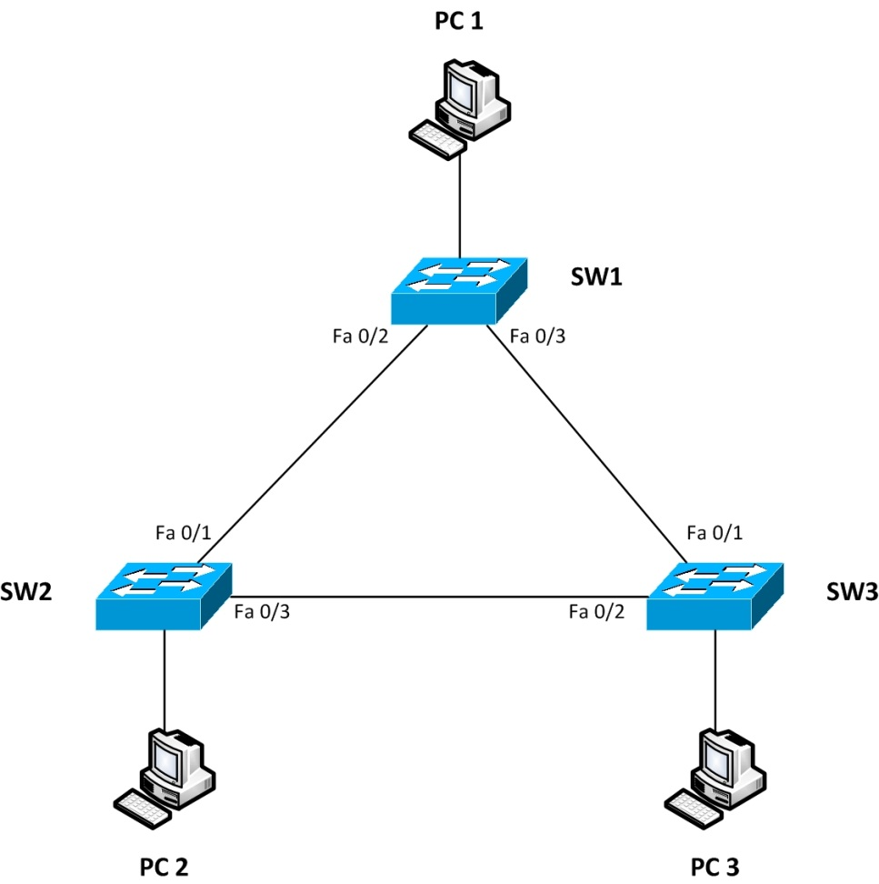
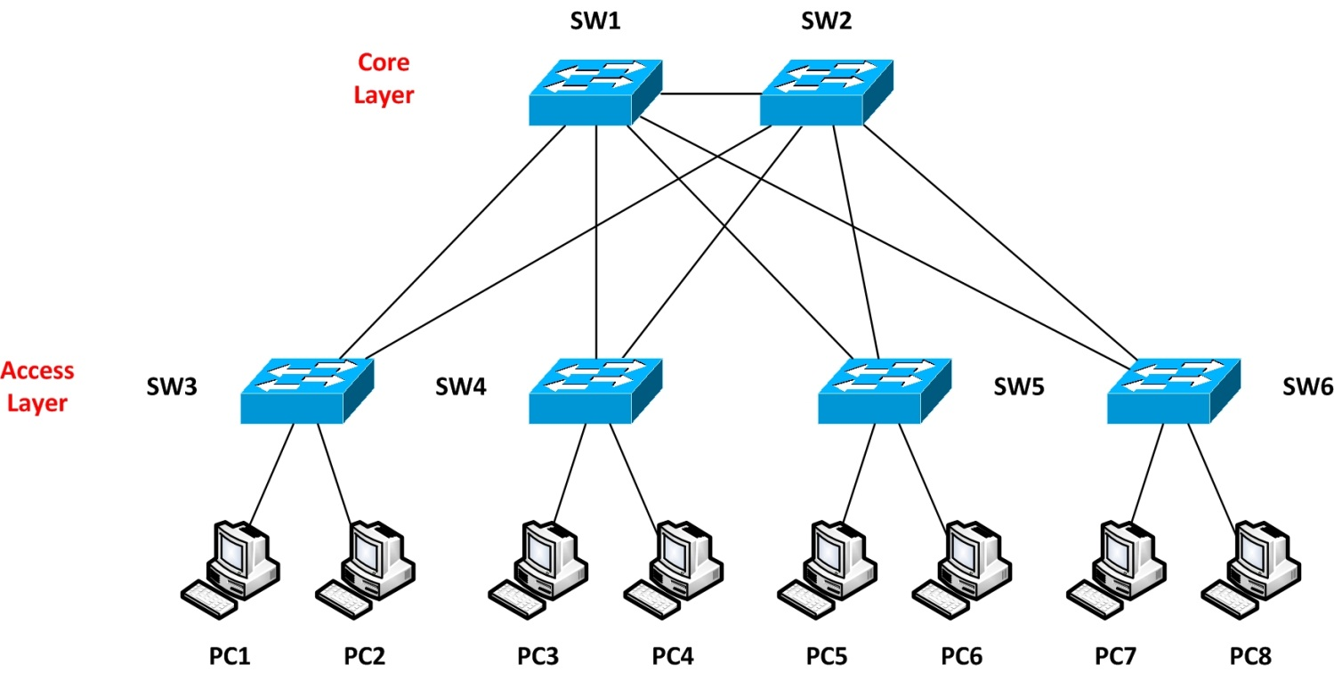
Switching
STP
Spanning Tree Protocol (STP)
IEEE 802.1D
Prevent loops in bridge networks
Redundant Link
Broadcast storm
Multiple frame transition
Unstable MAC-Address table

Slide 3
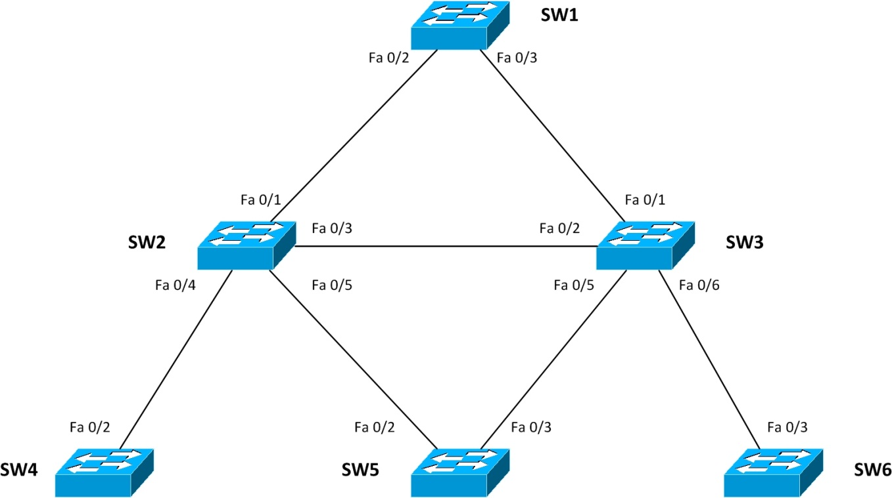
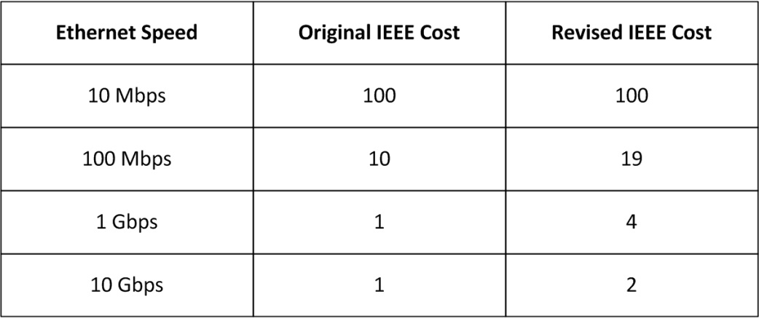
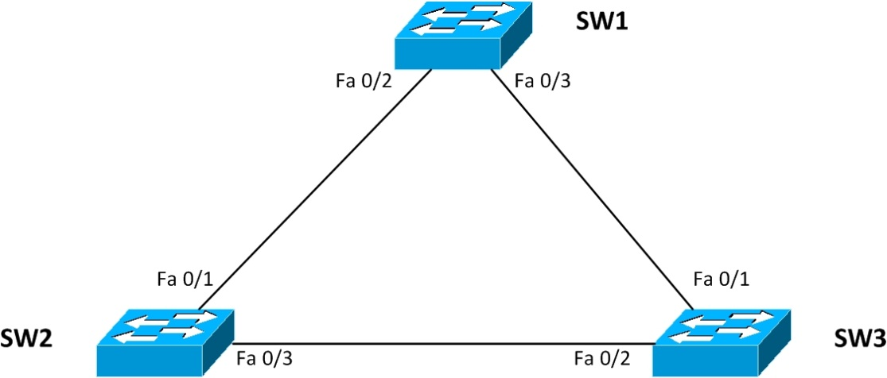
Switching
STP
STP Terminology
Root Bridge
Bridge ID (BID)
Bridge Protocol Data Unit (BPDU)
Root Port (RP)
Designated Port (DP)
Block Port (BP)
Root path cost
Bridge ID (BID)
Priority (2 byte)
Default Priority = 32768
MAC address (6 byte)
Bridge Protocol Data Unit (BPDU)
Send every 2 sec
Multicast to 01:80:C2:00:00:00
Root bridge ID
Sender’s bridge ID
Cost to reach root bridge
Timer value on the root bridge

Slide 4
Switching
STP
STP Operation
select root bridge in a topology
Select root port
Select designated port
Define block port
Selection parameters
Lowest root bridge ID
Lowest root path cost
Lowest sender bridge ID
Lowest sender port ID

Slide 5
Switching
STP
STP Timers
Hello time → 2 sec
Forward delay → 15 sec
Maximum age → 20 sec
Port State
Blocking
Listening
Learning
Forwarding
disabled

Slide 6
Switching
STP
Topology Change
Direct Topology Change
Interface change state to down
Listening state = 15 sec
Learning state = 15 sec
Indirect Topology Change
Interface is up
Max age = 20 sec
Listening state = 15 sec
Learning state = 15 sec

Slide 7
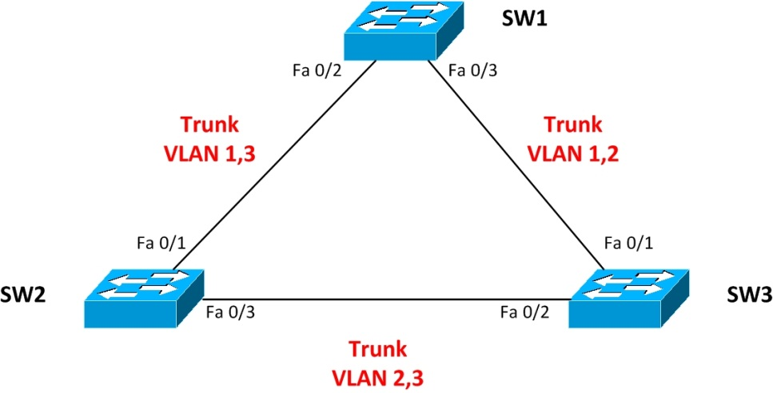
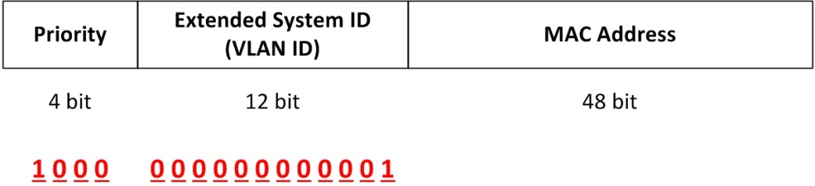
Switching
STP
Cisco PVST+
Bridge ID
Priority (4 bit)
Extended System ID (12 bit)
MAC Address (48 bit)

Slide 8
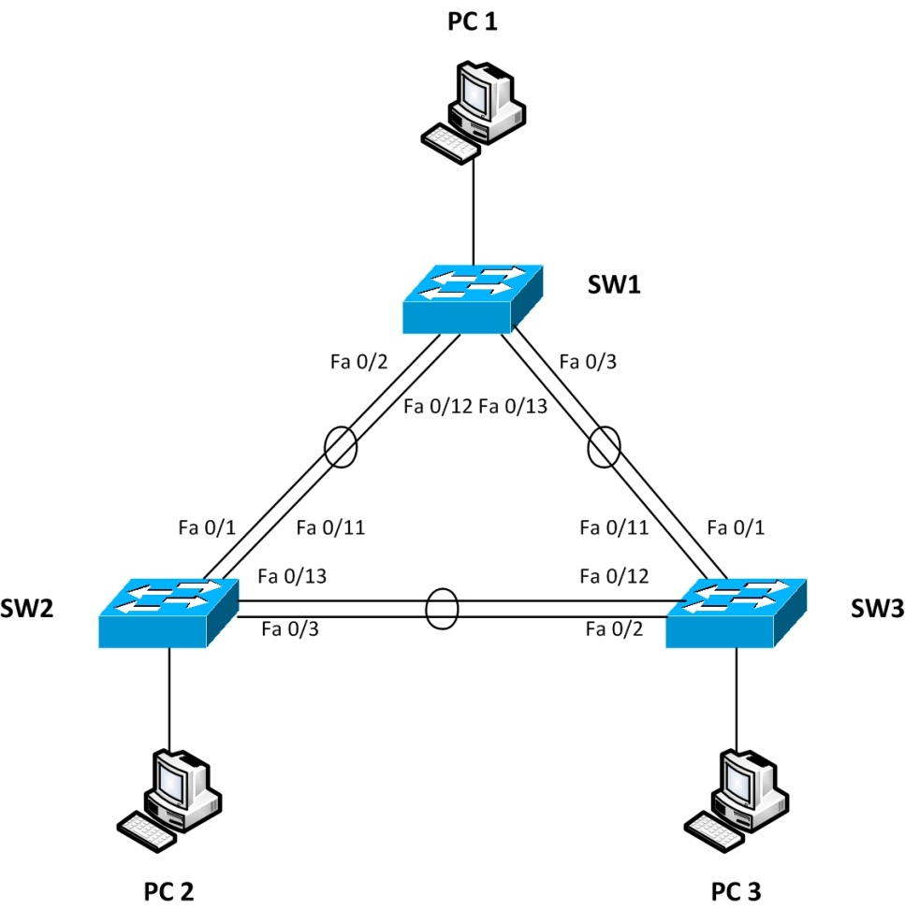
Switching
STP
Cisco proprietary parameters
Port fast
BPDU guard
Etherchannel

Slide 9
Switching
STP
STP Configuration
(config)#spanning-tree vlan ___ priority ___
(config-if)#spanning-tree vlan ___ cost ___
#show spanning-tree vlan ___
#show spanning-tree
#debug spanning-tree events

Slide 10
Switching
STP
STP parameters configuration
Port fast
(config-if)#spanning-tree portfast
BPDU guard
(config-if)#spanning-tree bpduguard enable
Etherchannel
(config-if)#channel-group __ mode on
#show etherchannel

Slide 11
Switching
STP
STP

